Slide 1
Modeling Concepts
ER Diagram

Slide 2


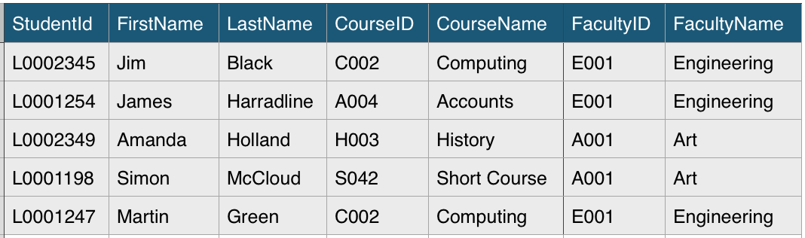



What is ER Diagram ?
FirstName
FacultyName
FacultyID
StudentID
LastName
Student
m
Study
1
Faculty
1
Provide
CourseID
m
m
Enroll
n
Course
CourseName
ER Diagram
ER model is the blueprint of a database
Graphical tool for modeling data
ER diagrams are translatable into relational tables

Slide 3



Basic Components of ER Diagram
FirstName
FacultyName
FacultyID
StudentID
LastName
Student
m
Study
1
Faculty
1
Provide
CourseID
m
m
Enroll
n
Course
CourseName
ER Diagram
Entity
e.g. Student, College, Employee, Region
One to One 1-1
Person has only one passport and a passport is given to one person
Relationship
One to Many 1-m
A student can can study in only one faculty but a faculty can have many students
Many to Many m-m
Student can enroll to many courses and a course can be enrolled by many students
Attribute
e.g. property or characteristic of the entity

Slide 4
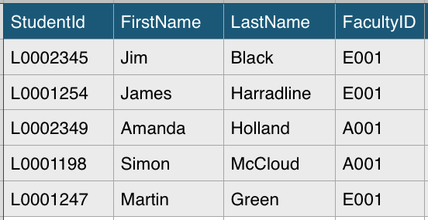
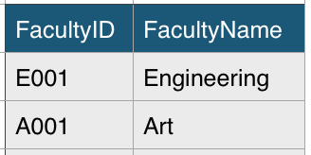
Basic Components of ER Diagram
Primary Key
Uniquely identifies an instance of the entity.
Attribute
Unique , never changing, never null
Foreign Key
Referencing key is used to link two tables together
It can replicate, can be null
Primary Key
Foreign Key
Student
StudentID | PK
FirstName
LastName
FacultyID | FK
Faculty
FacultyID | PK
FacultyName
Primary Key

Slide 5
ER Diagram to Relational Data Model
ER Diagram
Relational Data Model
FirstName
Faculty
FacultyID | PK
FacultyName
FacultyName
FacultyID
1
1
StudentID
LastName
Student
m
Study
1
Faculty
1
Student
StudentID | PK
FirstName
LastName
FacultyID | FK
1
Course
CourseID | PK
CourseName
FacultyID | FK
Provide
1
CourseID
m
m
Enroll
n
Course
n
CourseName
n
Enrollment
StudentID | PK,FK1
CourseID | PK,FK2
n
n

Slide 6
Modeling Concepts
Modeling Types

Slide 7








Data Modeling Remarks
What is Data Modeling
Who are the modelers
Modeling Types
LDM
CDM
LDM
PDM

Slide 8
Modeling Types
Time
Region
Time
Region
Time
Region
Region ID (INT)
Time ID (INT)
Region ID
Time ID
Region(Varchar)
City (Varchar)
Channel (Varchar)
Year (INT)
Month (INT)
Week (INT)
Region
City
Channel
Year
Month
Week
Sales
Sales
Sales
Sales ID (PK)
Sales ID (INT)
Region ID (FK)
Region ID (INT)
Time ID (FK)
Time ID (INT)
Amount
Price
Amount (INT)
Price (FLOAT)
Conceptional
Data Modeling
Logical
Data Modeling
Physical
Data Modeling
Highly abstract
Easily Enhanced
Only Entities and Abstract Relationships
No software tool required to define CDM
Presence of Attributes
PK & FK relations
DM tools like ERW and Power Designer can be used to
They can be converted to PDM with help of these tools
Entities referred as Tables
Attributes referred as columns
Database compatible table names and columns and db specific data types

Slide 9
Modeling Concepts
OLTP & DWH

Slide 10
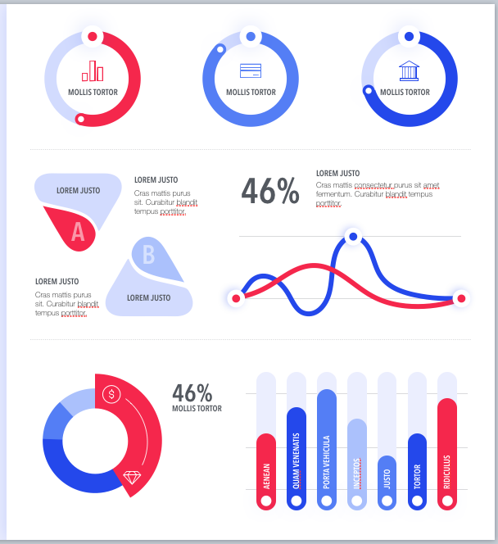




What is OLTP ? (Online Transactional Processing System)
OLTP
Acc
Sales
Controlling
CRM
Finance
Customer
Individual Contact
Relational
Non-Relational
SQL
DB2
Cassandra
Oracle
MangoDB
Marketing
Customer
Individual Contact
Organisation
HADOOP
Minimize Locking
Fast Data Insert & Update
Not suitable for reporting
Simple queries

Slide 11


What is Data Warehouse ? (Online Analytical Processing System - OLAP)
Source System
ETL (Staging)
DWH
Front end
Acc
Reporting
Sales
Analytics
CRM
Mining
Why do we need DWH ?
More accessible for end-users
Make strategic decisions
Store historical data
Single Point of Truth
Higher data quality and data integrity
Faster decisions

Slide 12









DWH Architecture ?
Data Source
Staging
Storage
Presentation
Mining
ETL
ETL
Validate
Clean
Transformation
Rules
Analytics
Reporting
ETL
ERP, CRM, Sales, Marketing
Extract & Transform & Load
Data Validation, Clean and Transformation
Clea, Transformed Data stored in DWH or DataMart
Reporting and Data Visualization
Relational , Non-Relational ,Text file
Title | Name | Surname
Mr | Eric | Stone
Mrs | Emma | Bild
Mr | George | Kilan
Mrs | Alice | Green
Staging Area
Data Mart
Intermediate Storage Area during ETL operations
Hold the data in temporary tables
1 to 1 copies of tables from the source system
Smaller Sub-set of Data
One Subject Area
Easier Maintenance
Name
Mr. George Kilan
Mrs. Alice Green
Title | Name | Surname
Mr | Eric | Stone
Mrs | Emma | Bild

Slide 13
OLTP & DWH ?
OLTP
DWH
OLTP Performance is about Inserting and Updating quickly
Locking must be minimized
Small sets of data retrieved in a query
Normalized data model
Based on current data
Used by employees on the front-line, like clerks and cashiers, to record and review transactions
DWH Performance is about retrieving the data quickly
Locking is not an issue
Large sets of data retrieved in a query
De-normalized data model
Based on historical data
Used by knowledge workers, like C-suite and analysts, to run complex queries for analysis

Slide 14
Modeling Concepts
Normalization & Denormalization

Slide 15
Data Optimization
Normalization
Optimization Technique
Denormalization
Relational Data Model
Student_ID | Name | Surname | State | Country
100 | Jim | Black | LA | US
101 | Amanda | Holland | NY | US
102 | Martin | Kilan | Berlin | Germany
103 | Alice | Green | London | UK
Relational Database
SQL Server, Oracle, MySQL

Slide 16

Normalization
Normalization is the process which divides larger tables into smaller tables to minimize data redundancy
Commonly Used Normal Forms
Student_ID | Name | Surname | Course_ID | CourseName
100 | Jim | Black | C001 | Coding
101 | Amanda | Holland | C001 | Coding
102 | Martin | Kilan | C001 | Coding
103 | Alice | Green | C001 | Coding
First Normal Form
Second Normal Form
Third Normal Form
Redundancy
Insert Anomaly
Delete Anomaly
Update Anomaly
Student_ID | Name | Surname | Course_ID | CourseName
100 | Jim | Black | C001 | Coding
101 | Amanda | Holland | C001 | Coding
102 | Martin | Kilan | C001 | Coding
103 | Alice | Green | C001 | Coding
Student_ID | Name | Surname | Course_ID | CourseName
100 | Jim | Black | C001 | Coding
101 | Amanda | Holland | C001 | Coding
102 | Martin | Kilan | C001 | Coding
103 | Alice | Green | C001 | Coding
Student_ID | Name | Surname | Course_ID | CourseName
100 | Jim | Black | C001 | Coding
101 | Amanda | Holland | C001 | Coding
102 | Martin | Kilan | C001 | Coding
103 | Alice | Green | C001 | Coding
Java
Java
104 | Jason | Brown | C001 | Coding
Java
105 | Kim | Flower

Slide 17
1NF
1NF (First Normal Form)
Column cell of a table cannot hold multiple values
Student_ID | Name | Surname | State | Country | CourseName
100 | Jim | Black | LA | US | Coding, Accounting
101 | Amanda | Holland | NY | US | Coding
102 | Martin | Kilan | Berlin | Germany | Coding, Accounting
103 | Alice | Green | London | UK | Coding
Student_ID | Name | Surname | State | Country | CourseName
100 | Jim | Black | LA | US | Coding
100 | Jim | Black | LA | US | Accounting
101 | Amanda | Holland | NY | US | Coding
102 | Martin | Kilan | Berlin | Germany | Coding
102 | Martin | Kilan | Berlin | Germany | Accounting
103 | Alice | Green | London | UK | Coding

Slide 18
2NF
2NF (Second Normal Form)
Achieved the first normal form
Redundant data across multiple rows of a table must be moved to separate table
Student_ID | Name | Surname | State | Country | CourseName
100 | Jim | Black | LA | US | Coding
100 | Jim | Black | LA | US | Accounting
101 | Amanda | Holland | NY | US | Coding
102 | Martin | Kilan | Berlin | Germany | Coding
102 | Martin | Kilan | Berlin | Germany | Accounting
103 | Alice | Green | London | UK | Coding
Composite Key
(Student_ID & CourseName)
Student_ID | Course_ID
100 | C001
100 | A001
101 | C001
102 | C001
102 | A001
103 | C001
Student_ID | Name | Surname | State | Country
100 | Jim | Black | LA | US
101 | Amanda | Holland | NY | US
102 | Martin | Kilan | Berlin | Germany
103 | Alice | Green | London | UK
Course_ID | CourseName
C001 | Coding
A001 | Accounting
Student
Student_Course
Course

Slide 19
3NF
3NF (Third Normal Form)
Achieved the second normal form
Eliminate fields that do not depend on the primary key
Student_ID | Name | Surname | State | Country
100 | Jim | Black | LA | US
101 | Amanda | Holland | NY | US
102 | Martin | Kilan | Berlin | Germany
103 | Alice | Green | London | UK
Student
Student_ID | Course_ID
100 | C001
100 | A001
101 | C001
102 | C001
102 | A001
103 | C001
Student_ID | Name | Surname | State_ID
100 | Jim | Black | 1
101 | Amanda | Holland | 2
102 | Martin | Kilan | 3
103 | Alice | Green | 4
State_ID | State | Country
1 | LA | US
2 | NY | US
3 | Berlin | Germany
4 | London | UK
Course_ID | CourseName
C001 | Coding
A001 | Accounting
Student
Origin
Student_Course
Course

Slide 20
Denormalization
Denormalization is the process where data from multiple tables are combined into one table, so that data retrieval will be faster.
Student_ID | Course_ID
100 | C001
100 | A001
101 | C001
102 | C001
102 | A001
103 | C001
Student_ID | Name | Surname | State_ID
100 | Jim | Black | 1
101 | Amanda | Holland | 2
102 | Martin | Kilan | 3
103 | Alice | Green | 4
State_ID | State | Country
1 | LA | US
2 | NY | US
3 | Berlin | Germany
4 | London | UK
Course_ID | CourseName
C001 | Coding
A001 | Accounting
Student
Origin
Student_Course
Course
SK_Student_ID | Student_ID | Name | Surname | State | Country | CourseName
1 | 100 | Jim | Black | LA | US | Coding
2 | 100 | Jim | Black | LA | US | Accounting
3 | 101 | Amanda | Holland | NY | US | Coding
4 | 102 | Martin | Kilan | Berlin | Germany | Coding
5 | 102 | Martin | Kilan | Berlin | Germany | Accounting
6 | 103 | Alice | Green | London | UK | Coding
DIM_Student

Slide 21
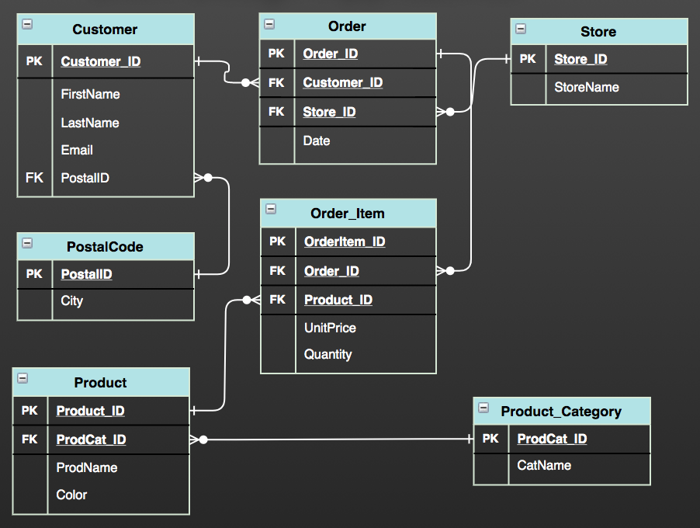
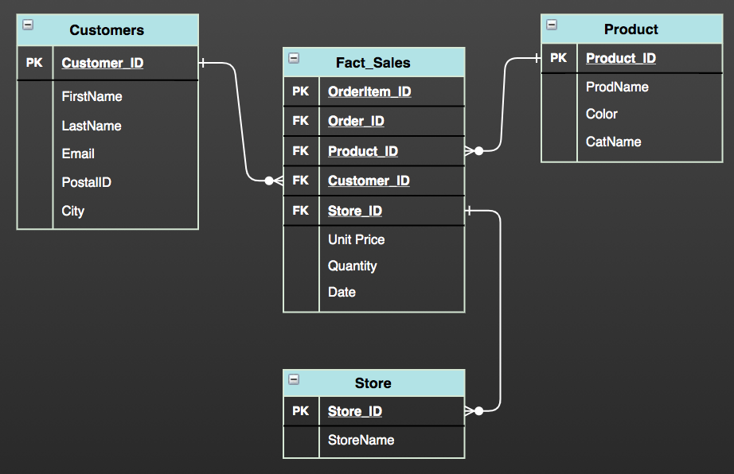
Normalization & Denormalization
Normalization
Denormalization
Implementation
Divides larger tables into smaller tables reduce redundancy
Combining tables into larger table creates redundancy
Number of Tables
Increase Number of tables hence joins
Decrease Number of tables hence joins
Query Execution
Speed of update, delete and write operations is higher
Speed of read operations is higher hence faster execution of the queries
Used In
OLTP system, emphasize fast write operations
OLAP system, emphasize fast read operations
Memory Consumption
Memory consumption is less due to less redundancy
Memory consumption is more due to redundancy

Slide 22
Why Normalization is important for OLTP ?
Write Operation
Product Category : “Computer” to “Electronic"
ProdCat_ID | CatName
1 | Computer Electronic
2 | Sports
3 | Beauty
Update single record
Read Operation
Customer detail purchased products from the category of “Electronic“ in store “LA”
Costly join operation with 6 tables

Slide 23
Why Denormalization is important for OLAP ?
Write Operation
Product Category : “Computer” to “Electronic"
ProdCat_ID | ProdName | Color | CatName
1 | Computer | Black | Electronic
2 | Shoe | White | Sports
3 | Phone | White | Electronic
4 | TV | Black | Electronic
Update multiple records
Read Operation
Customer detail purchased products from the category of “Electronic“ in store “LA”
Join operation with 4 tables

Slide 24
OLTP & OLAP
Normalized - OLTP
Denormalized - OLAP
Write Operation
Write Operation
Product Category : “Computer” to “Electronic"
Product Category : “Computer” to “Electronic"
ProdCat_ID | CatName
1 | Computer Electronic
2 | Sports
3 | Beauty
ProdCat_ID | ProdName | Color | CatName
1 | Computer | Black | Electronic
2 | Shoe | White | Sports
3 | Phone | White | Electronic
4 | TV | Black | Electronic
Update single record
Update multiple records
Read Operation
Read Operation
Customer detail purchased products under the category of “Electronic“ from store “LA”
Customer detail purchased products under the category of “Electronic“ from store “LA”
Costly join operation with 6 tables
Join operation with 4 tables

Slide 25
Modeling Concepts
DWH Design Approaches

Slide 26



DWH Design Approaches
DWH Design Approaches
Data Store
Data Modeling Method in DWH
Schema
(Arrangement of Tables )
Bill Inmon
Third Normal
Form
Enterprise DWH
ER Modeling
Top Down
Data Mart
Dimensional
Model
Right Data Warehouse Design
Ralph Kimball
Star Schema
Bottom Up
Data Mart
Dimensional
Model
Enterprise DWH
Snowflake
 | Design Approach | Data Modeling | Table Structure | Schema
OLTP |  | ER Modeling | Normalized | 3NF
DWH (OLAP) | Inmon ( Bottom-Up) | ER Modeling | Normalized | 3NF
 | Kimbal (Top-Down) | Dimensional Modeling | Denormalized | Star & Snowflake

Slide 27
DWH Design Approaches
Top Down Approach (Inmon)
Source System
ETL (Staging)
Enterprise
DWH
ETL
DataMart 1
Emphasize Enterprise DWH
The DW has atomic level data
Data marts have summary
The DW ER-based normalized model
Data marts subject specific dimensional model
Acc
ER
DataMart 2
Sales
DM
CRM
DataMart 3
Bottom Up Approach (Kimball)
Source System
ETL (Staging)
DataMart 1
ETL
Enterprise
DWH
Emphasize Data Mart (DM)
DM based on denormalized dimensional model
DM contain both atomic and summary data
DM integrated using conformed dimensions
Acc
DataMart 2
Sales
DM
CRM
DataMart 3
DM

Slide 28
Advantages & Disadvantages
Source
ETL
DataMart
Source
ETL
DataMart
TOP DOWN
Enterprise
DWH
BOTTOM UP
Enterprise
DWH
Advantages
Advantages
Single point of truth
Flexible Enterprise changes
Subsequent project cost is lower
Quick to set-up and build
Performance of the star schema is good
Easier to extend the data warehouse
Disadvantages
Disadvantages
Inflexible to changing departmental needs quickly
The model become complex over time
The initial set-up and delivery will take more time
The essence of the ‘one source of truth’ is lost
Initial cost is low but subsequent phase will cost same
Data is redundant due to denormalized data model

Slide 29
Modeling Concepts
Dimensional Modeling

Slide 30
Modeling Recap
OLTP
DWH
DWH Methods
Data Modeling
Schema
(Arrangement of Tables)
Acc
ER Model
(Normalized)
Top Down (Inmon)
3NF
Sales
Star Schema
Bottom Up (Kimball)
Dimensional Model
(Denormalized)
CRM
Snowflake
Fast Write Operations
ER Model - 3NF
Reduce Redundancy
Fast Data Retrieval
Complex Queries
High Performance

Slide 31


Dimensional Modeling Basics
Easy to use, write queries quickly and effectively
Main goal is fast data retrieval
Fact
Dimension
Sales Revenue
Amount
Quantity
Customer
Location
Product
Store
Location
Attribute
Country
City
Zipcode
Customer
Sales Number
Product

Slide 32
Fact & Dimension
Fact Table
Dim_Date
Date_ID | PK
Date
Monty
Year
Dim_Product
Product_ID | PK
ProdName
Category
Includes numerical values (Amount, Quantity)
Includes foreign keys to associated dimension tables
Sales Fact
Date_ID | PK
Customer_ID | FK
Product_ID | FK
Channel_ID | FK
Amount
Quantity
Dimension Table
Descriptive characteristics of the facts
Joined to fact table via a foreign key
De-normalized tables.
Use a surrogate key
Store the history
Dim_Customer
Cust_ID | PK
FirstName
LastName
Email
PostalCode
City
Dim_Channel
Channel_ID | PK
ChannelName
Description

Slide 33
Why Dimension Modeling is Important ?
Ease of understanding
Faster database performance
Flexible to business change
Easy Reporting
Historical Data

Slide 34
Dimensional & 3NF
Dimensional Model
Normal Form Model
Used In
OLAP
OLTP
Structure
Denormalized
Normalized
Operation
Fast read operations
Fast write operations (insert,update,delete)
Query Performance
Higher Performance
Lower Performance
Business Usage
Easy
Difficult

Slide 35
Modeling Concepts
Star & Snowflake Schema

Slide 36
Star Schema & Snowflake Schema
Star Schema
Snowflake Schema
Dim_Date
Date_ID | PK
Date
Monty
Year
Dim_Product
Product_ID | PK
ProdName
Category
Dim_Date
Date_ID | PK
Date
Monty
Year
Dim_Product
Product_ID | PK
ProdName
Category
Sales Fact
Date_ID | PK
Customer_ID | FK
Product_ID | FK
Channel_ID | FK
Amount
Quantity
Sales Fact
Date_ID | PK
Customer_ID | FK
Product_ID | FK
Channel_ID | FK
Amount
Quantity
Dim_Customer
Customer_ID | PK
FirstName
LastName
Email
PostalCode
City
Adress
Dim_Channel
Channel_ID | PK
ChannelName
Description
Store_Name
Dim_Customer
Customer_ID | PK
FirstName
LastName
Email
Postal_ID | FK
Dim_Channel
Channel_ID | PK
ChannelName
Store_ID | FK
Dim_Store
Store_ID | PK
Store_Name
Type
Dim_Location
Postal_ID | PK
City
Adress
Dimension tables do not join each other
Dimension tables denormalized
Fact table include key and measures
Uses smaller disk space
Dimension tables less denormalized
Reduced query performance

Slide 37
Star Schema & Snowflake Schema
Star Schema
Snowflake Schema
Normalization
Denormalized
Denormalized + Normalized
Maintenance
More Redundancy
Less Redundancy
Query
Simple Queries due to Denormalization
Complex Queries due to Normalization
Joins
Less Joins
More Joins
Performance
Faster Performance
Relatively Slow Performance

Slide 38
Slowly Changing Dimensions
Slowly changing dimensions are used to capture changing data within the dimension over time
Source
Customer_ID | First_Name | LastName | Cust_Type
100 | Jim | Black | Corporate, Retail
101 | Amanda | Holland | Retail
Target
Type-1
Customer_ID | First_Name | LastName | Cust_Type
100 | Jim | Black | Retail
101 | Amanda | Holland | Retail
Overwrite the existing data values
Lose the historical value
Often used for data corrections
Type-2
SID | Customer_ID | First_Name | LastName | Cust_Type | Start_Date | End_Date | Current_Flag
1 | 100 | Jim | Black | Corporate | 24-05-2016 | 14-07-2018 | N
2 | 101 | Amanda | Holland | Retail | 10-03-2016 | 31-12-9999 | Y
3 | 100 | Jim | Black | Retail | 15-07-2018 | 31-12-9999 | Y
Creating a new additional record
History of dimension changes is kept
Expensive database operation
Type-3
Customer_ID | First_Name | LastName | Current | Previous
100 | Jim | Black | Retail | Corporate
101 | Amanda | Holland | Retail | Retail
Add a second column to store the most recent past value
Seldom used type

Slide 39
Surrogate Key
SID | Customer_ID | First_Name | LastName | Cust_Type | Start_Date | End_Date | Current_Flag
1 | 100 | Jim | Black | Corporate | 24-05-2016 | 14-07-2018 | N
2 | 101 | Amanda | Holland | Retail | 10-03-2016 | 31-12-9999 | Y
3 | 100 | Jim | Black | Retail | 15-07-2018 | 31-12-9999 | Y
Sequentially generated unique number
Eliminate source system dependency
Increase performance with using suitable data type on joins

Slide 40
Conformed Dimensions
Dim_Customer
Customer_ID | PK
FirstName
LastName
Email
PostalCode
City
Shared by many fact tables
Same meaning with every fact table join
Reduce development cost by reusing dimensions
Same structure and attributes in every model
Allow various fact tables to be used in the same query
Sales Fact
Date_ID | PK
Customer_ID | FK
Product_ID | FK
Channel_ID | FK
Amount
Quantity
Shipment_Fact
Shipment_ID | PK
Customer_ID | FK
Product_ID | FK
Date
Shipping_Cost
Quantity
Dim_Product
Product_ID | PK
ProdName
Category

Slide 41
Modeling Concepts
Practise-1 ER to Dimensional Model

Slide 42
Agenda
Business Processes
ER Diagram
Relational Database
3NF
Dimensional Model

Slide 43










Sample Business Processes
Store A
Store B
Customer
Product
Product Category
Store
Order

Slide 44
ER Diagram
FirstName
LastName
StoreID
StoreName
Email
Name
OrderID
OrderDate
CustomerID
Customer
1
Places
m
Order
n
Occur
1
Store
n
Unitprice
Includes
Quantity
m
ProductID
Adress
Product
n
ProductName
PostalCode
City
Belongs
1
Category
CategName
CategID

Slide 45
ER Diagram to Relational Data Model
Customer
Cust_ID | PK
FirstName
LastName
Email
PostalCode
City
Order
Order_ID | PK
Cust_ID | FK
Store_ID | FK
Date
Store
Store_ID | PK
StoreName
Order_Item
Orderitem_ID | PK
Order_ID | FK
Product_ID | FK
Unitprice
Quantity
Product_Category
ProdCat_ID | PK
CatName
Product
Product_ID | PK
ProdName
ProdCat_ID | FK

Slide 46
1NF
1NF (First Normal Form)
Column cell of a table cannot hold multiple values
Student_ID | Name | Surname | State | Country | CourseName
100 | Jim | Black | LA | US | Coding, Accounting
101 | Amanda | Holland | NY | US | Coding
102 | Martin | Kilan | Berlin | Germany | Coding, Accounting
103 | Alice | Green | London | UK | Coding
3NF (Third Normal Form)
Achieved the second normal form
Eliminate fields that do not depend on the primary key
2NF (Second Normal Form)
Achieved the first normal form
Redundant data across multiple rows of a table must be moved to separate table
Student_ID | Name | Surname | State | Country
100 | Jim | Black | LA | US
101 | Amanda | Holland | NY | US
102 | Martin | Kilan | Berlin | Germany
103 | Alice | Green | London | UK
Student_ID | Name | Surname | State | Country | CourseName
100 | Jim | Black | LA | US | Coding
100 | Jim | Black | LA | US | Accounting
101 | Amanda | Holland | NY | US | Coding
102 | Martin | Kilan | Berlin | Germany | Coding
102 | Martin | Kilan | Berlin | Germany | Accounting
103 | Alice | Green | London | UK | Coding
Student

Slide 47
Normalize Relational Data Model to 3NF
Customer
Cust_ID | PK
FirstName
LastName
Email
PostalCode | FK
Order
Order_ID | PK
Cust_ID | FK
Store_ID | FK
Date
Store
Store_ID | PK
StoreName
When city name of postal code changed , before I normalized relational model
I need to update city info for each customer_id , but in normalized form ,
ı would update only postal code table
Order_Item
Orderitem_ID | PK
Order_ID | FK
Product_ID | FK
Unitprice
Quantity
PostalCode
PostalCode | PK
City
Product_Category
ProdCat_ID | PK
CatName
Product
Product_ID | PK
ProdName
ProdCat_ID | FK

